Slide 1
About this lecture....
In this lecture we will discuss
  Disk capacity
  Disk operations
  Organization of data on disk
  Functions of disk controller
  Disk arrays.

Slide 2
Disk Capacity
Depends on:
  Number of surfaces (S)
  Number of tracks/surface (or number of cylinders) (T)
  Number of sectors/track (N)
  Number of bytes/sector (B)
Capacity = S * T * N * B bytes
Bit Density Maximum at Inner Tracks.

Slide 3
Total Time for a Read/Write Operation
Seek Time (to reach to appropriate track).
Latency (to reach to appropriate sector).
Data transfer time
Rotation time
Average latency = half of the rotation time
Sum of seek time and latency is known as access time.
Data transfer time = rotation time/ number of sectors per track.
Access time is much larger than data transfer time for a sector.

Slide 4
Timing Information
Needed to determine sector and track positions on data tracks.
Bit timing may not needed because of data encoding.
However, we need to identify the start of sectors on a track.
Done by special recording on the disk at sector boundaries.
First sector is noted by either a physical mark (e.g., a hole in the floppy disk) or by a unique data pattern on the disk.

Slide 5
Time for Read/Write
Consider a disk with
S = 21, T = 2627, N = 99, B = 512, Average Seek Time = 11ms, Speed 5400 RPM.
Capacity = 21*2627*99*512 = 2.8 GByte.
Latency = 0.5 * (60/5400) sec = 5.6 msec
Data transfer rate = 99*512*5400/60 Bytes/Sec = 4.6 MByte/Sec
Transfer time for one sector = 512/4.6 ×10⁻⁶ sec.
= 0.11 ms.
Average time to read any sector = 11 ms + 5.6 ms + 0.11 ms = 16.71 ms.

Slide 6
Improvement of HDD characteristics over time
Parameter | Started with (1956) | Developed to | Improvement
Capacity (formatted) | 3.75 megabytes | 10 terabytes | 2.7-million-to-one
Physical volume | 68 cubic feet (1.9 m³) | 2.1 cubic inches (34 cm³⁾ | 56,000-to-one
Weight | 2,000 pounds (910 kg) | 2.2 ounces (62 g) | 15,000-to-one
Average access time | about 600 milliseconds] | a few milliseconds | about 200-to-one
Price | US$9,200 per megabyte (1961) | $0.032 per gigabyte by 2015 | 300-million-to-one
Areal density | 2,000 bits per square inch | 826 gigabits per square inch in 2014 | greater than 400-million-to-one

Slide 7
Disk Scheduling
Based on the slides supporting the text

Slide 8
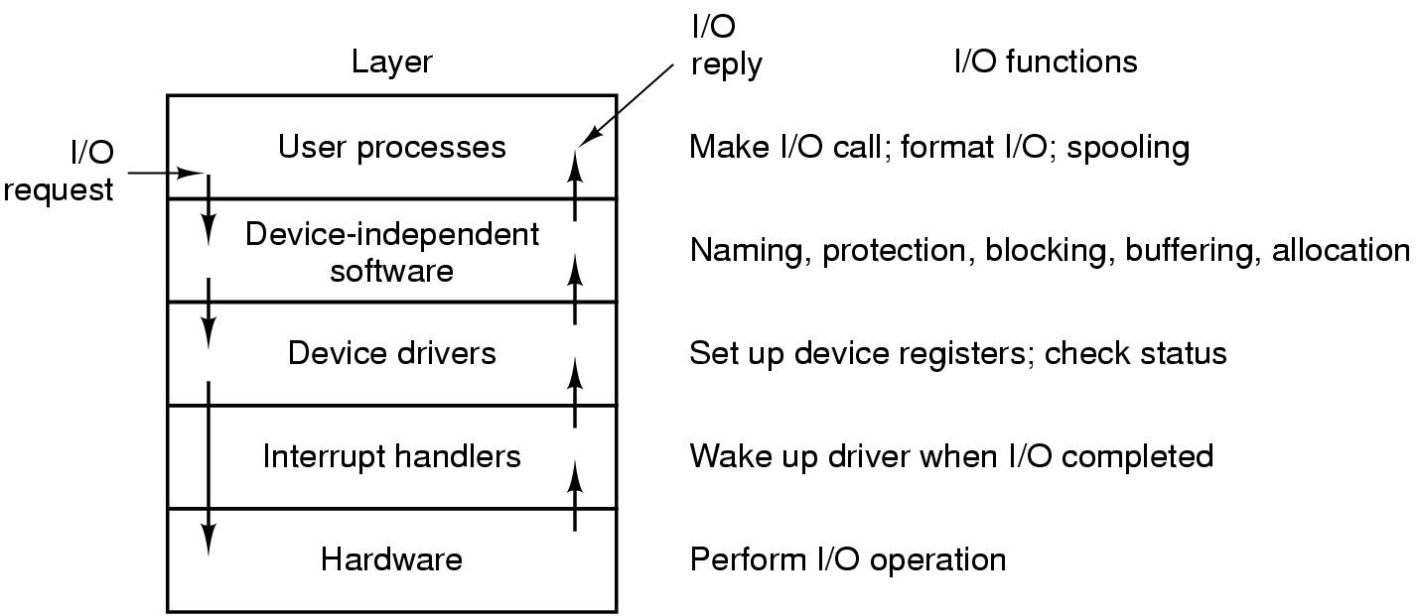
User-Space I/O Software
Layers of the I/O system and the main functions of each layer

Slide 9
Disk Structure
Disk drives are addressed as large 1-dimensional arrays of logical blocks, where the logical block is the smallest unit of transfer.
The 1-dimensional array of logical blocks is mapped into the sectors of the disk sequentially.
  Sector 0 is the first sector of the first track on the outermost cylinder.
  Mapping proceeds in order through that track, then the rest of the tracks in that cylinder, and then through the rest of the cylinders from outermost to innermost.
Lets understand track, sector and cylinder concept.

Slide 10
Disk Scheduling
The operating system is responsible for using hardware efficiently — for the disk drives, this means having a fast access time and disk bandwidth.
Access time has two major components
  Seek time is the time for the disk are to move the heads to the cylinder containing the desired sector.
  Rotational latency is the additional time waiting for the disk to rotate the desired sector to the disk head.
Minimize seek time
Seek time ≈ seek distance
Disk bandwidth is the total number of bytes transferred, divided by the total time between the first request for service and the completion of the last transfer.

Slide 11
Disk Scheduling (Cont.)
Several algorithms exist to schedule the servicing of disk I/O requests.
We illustrate them with a request queue (0-199).
98, 183, 37, 122, 14, 124, 65, 67
Head pointer 53

Slide 12

FCFS
Illustration shows total head movement of 640 cylinders.

Slide 13
SSTF
Selects the request with the minimum seek time from the current head position.
SSTF scheduling is a form of SJF scheduling; may cause starvation of some requests.
Illustration shows total head movement of 236 cylinders.

Slide 14

SSTF (Cont.)

Slide 15
SCAN
The disk arm starts at one end of the disk, and moves toward the other end, servicing requests until it gets to the other end of the disk, where the head movement is reversed and servicing continues.
Sometimes called the elevator algorithm.
Illustration shows total head movement of 208 cylinders.

Slide 16
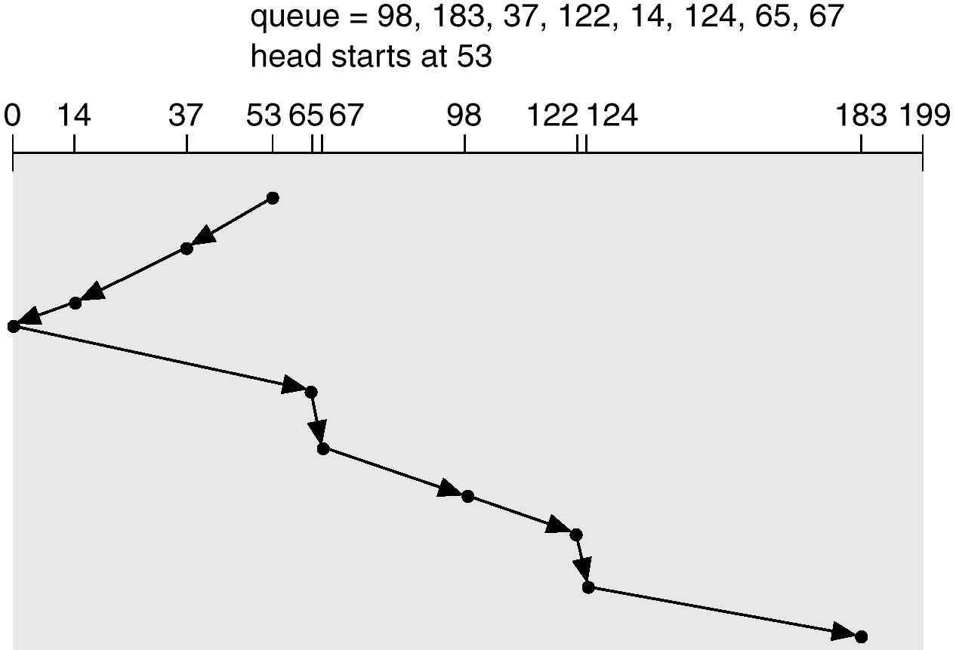
SCAN (Cont.)

Slide 17
C-SCAN
Provides a more uniform wait time than SCAN.
The head moves from one end of the disk to the other. servicing requests as it goes. When it reaches the other end, however, it immediately returns to the beginning of the disk, without servicing any requests on the return trip.
Treats the cylinders as a circular list that wraps around from the last cylinder to the first one.

Slide 18

C-SCAN (Cont.)

Slide 19
C-LOOK
Version of C-SCAN
Arm only goes as far as the last request in each direction, then reverses direction immediately, without first going all the way to the end of the disk.

Slide 20

C-LOOK (Cont.)

Slide 21
Selecting a Disk-Scheduling Algorithm
SSTF is common and has a natural appeal
SCAN and C-SCAN perform better for systems that place a heavy load on the disk.
Performance depends on the number and types of requests.
Requests for disk service can be influenced by the file-allocation method.
The disk-scheduling algorithm should be written as a separate module of the operating system, allowing it to be replaced with a different algorithm if necessary.
Either SSTF or LOOK is a reasonable choice for the default algorithm.

Slide 22
RAID
RAID – multiple disk drives provides reliability via redundancy.
Redundant Array of Independent Disks (RAID)
RAID is arranged into six different levels.
Several improvements in disk-use techniques involve the use of multiple disks working cooperatively.
Disk striping uses a group of disks as one storage unit.
RAID schemes improve performance and improve the reliability of the storage system by storing redundant data.
  Mirroring or shadowing keeps duplicate of each disk.
  Block interleaved parity uses much less redundancy.

Slide 23

RAID Levels

Slide 24
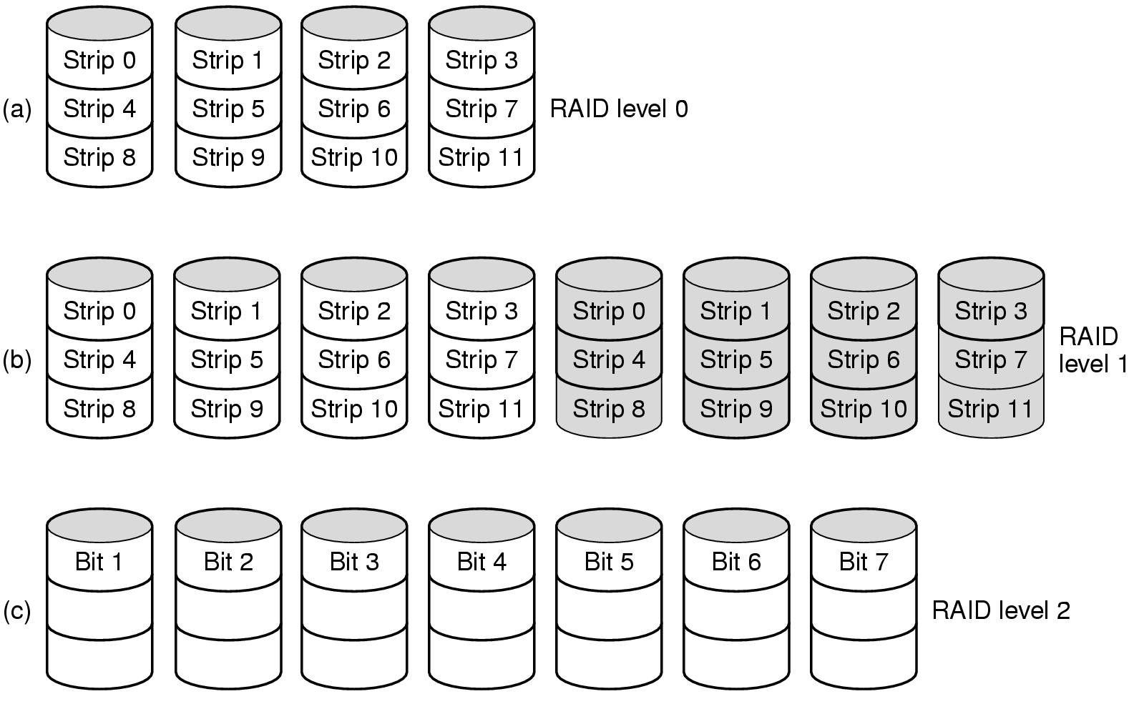
Raid Levels(continued)
Raid levels 0 through 2
Backup and parity drives are shaded

Slide 25
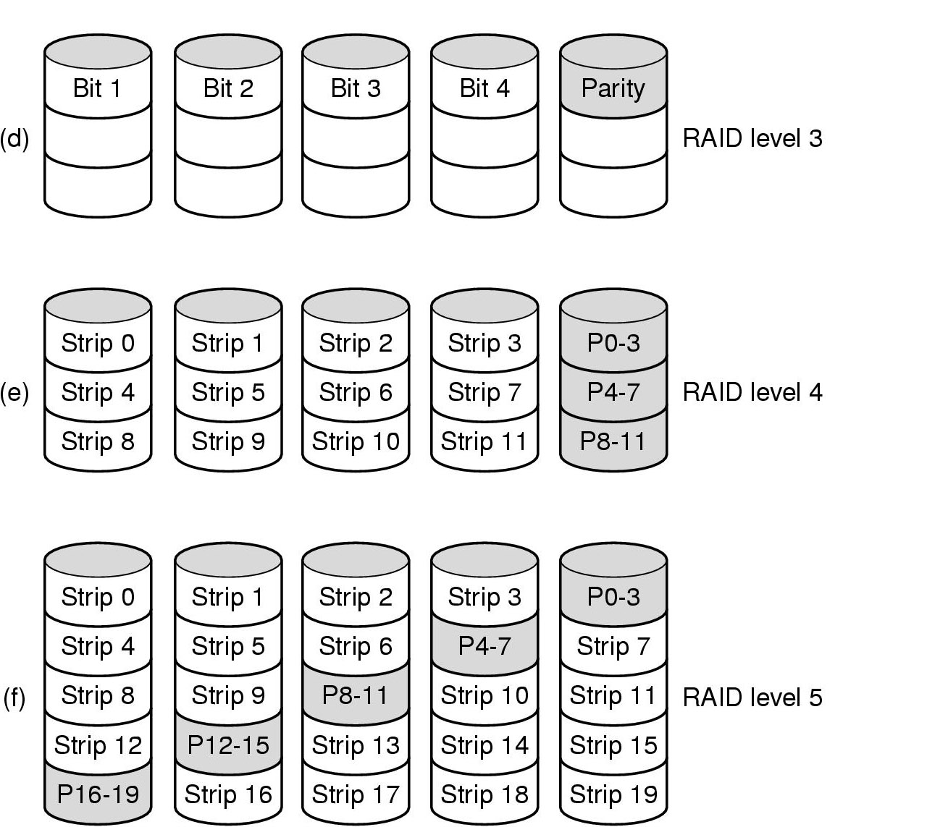
Raid Levels (continued)
Raid levels 3 through 5
Backup and parity drives are shaded

Slide 26
Raid Levels 6 and 7
RAID 6:P and Q redundancy
RAID 7: heterogeneous disks array

Slide 27
Disk Attachment
Disks may be attached one of two ways:
Host attached via an I/O port
Network attached via a network connection

Slide 28
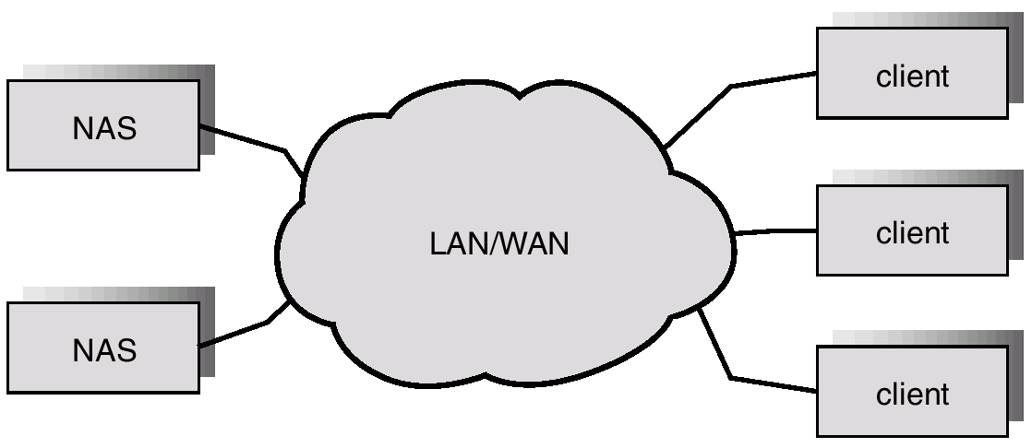
Network-Attached Storage(NAS)

Slide 29
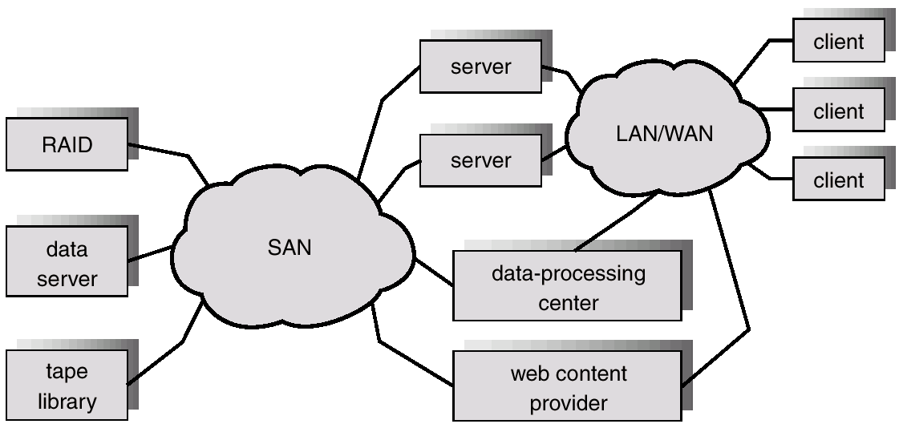
Storage-Area Network (SAN)

Slide 30
Summary
We looked various disk scheduling methods to optimize secondary storage access.
We also studies basic principles of RAID.
NAS and SAN are two recent advances in secondary storage.

Slide 31
Disk Scheduling Algorithms
Work Queue: 23, 89, 132, 42, 187
there are 200 cylinders numbered from 0 – 199
The disk head starts at number 100
First Come First Serve : 23, 89, 132, 42,187
Shortest Seek Time First: 100,89,132,187,42,23
Look : 100, 89,42,23,132,187
Scan: Assuming going towards 0: 100, 89,42,23,0,132,187
C-SCAN: 100, 89,42,23,0,199,187,132
C-LOOK: 100, 89,42,23, 187,132

Slide 32
Sequence of operations for disk read
Processor requests data.
To reduce the task of processing, a disk controller is used for disk control.
Controller interacts with the processor and provides an interface with the disk.
Processor request for data is processed by controller.
Controller seeks to the desired track, reads the desired sector and informs the processor by raising an interrupt.
Data from controller buffer may be read by the processor either under a program control or through DMA.

Slide 33

Disk Operations
Information needed by disk controller for data transfer:
  Disk address of first sector on the track to be read.
  Number of sectors to be read.
For, example the following format may be used.
Drive field specifies disk-drive if more than one drives are controlled by the same disk controller.

Slide 34
Organization of data on disk
Data is written in units of blocks by the operating system.
Each block is written in a sector.
Multiple blocks usually reside in logically consecutive sectors.
Logically consecutive sectors are not necessarily physically consecutive sectors.
This is done to improve the access and is called interleaving.
Track-to-track movement is needed only on cylinder-to-cylinder boundaries.

Slide 35
Functions of Disk Controller
Seek, Selection of desired track.
Move head-arm mechanically in case of moving-head systems.
Electronically select appropriate head for fixed head system.
Read, Reads data from a specified disk location.
Write, Writes to a specified disk location.
Write Check, Verification of data written.
  Reads data written and compares with data in controller buffer.
  Error message returned to processor in case of mismatch.

Slide 36
Synchronization
Interrupts can be raised by disk controller at completion of Seek, Read, Write and Write check operations.
Possess a look ahead register containing address of read/write head passing underneath Read/Write head to help operating system.

Slide 37
Winchester Disk Drives
Most common technology used in Hard Disk Systems.
Read/Write head attached to a slight airfoil operating as a flying read/write head.
Head few micro inches above surface of disk.
No contact between head and spinning disk reducing chances of wear due to rubbing.
Distance between head and surface small enough to read/write data through change in magnetic fields.

Slide 38
Disk Arrays
Disk systems provide single, serial bit stream during data transfer.
Disk arrays targeted to reduce access time and increasing bandwidth using multiple disks operating in parallel.
Require sophisticated technology to provide reliable high performance systems.
Commonly used technique is Redundant Array of Inexpensive Disks (RAID).

Slide 39
RAID
Redundant Array of Inexpensive Disks
Single large unit of stored in several disk units by breaking the data into small pieces.
Store each piece on separate disk (Data striping).
During read all disks can deliver data in parallel.
Buffering of data is needed to reassemble complete data before sending to requesting processor.
Transfer time reduced by a factor equal to number of disks.
Access time (seek time + latency) may not decrease.

Slide 40
Reliability enhancement using RAID
Data can be replicated on several disks (transparent to user).
If one of disk fails, duplicated data from other disk can be transferred.
During read, disk with shortest access time for each piece of data is accessed.
During Write, data has to be written on all disks
Total cost of system increases with increase in redundancy.
Variations of RAID (RAID0-RAID5) exist differing in data organization and redundancy schemes.

